Slide 1
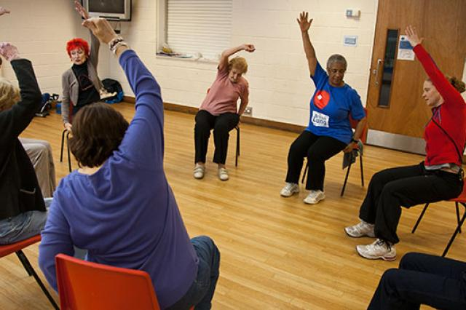
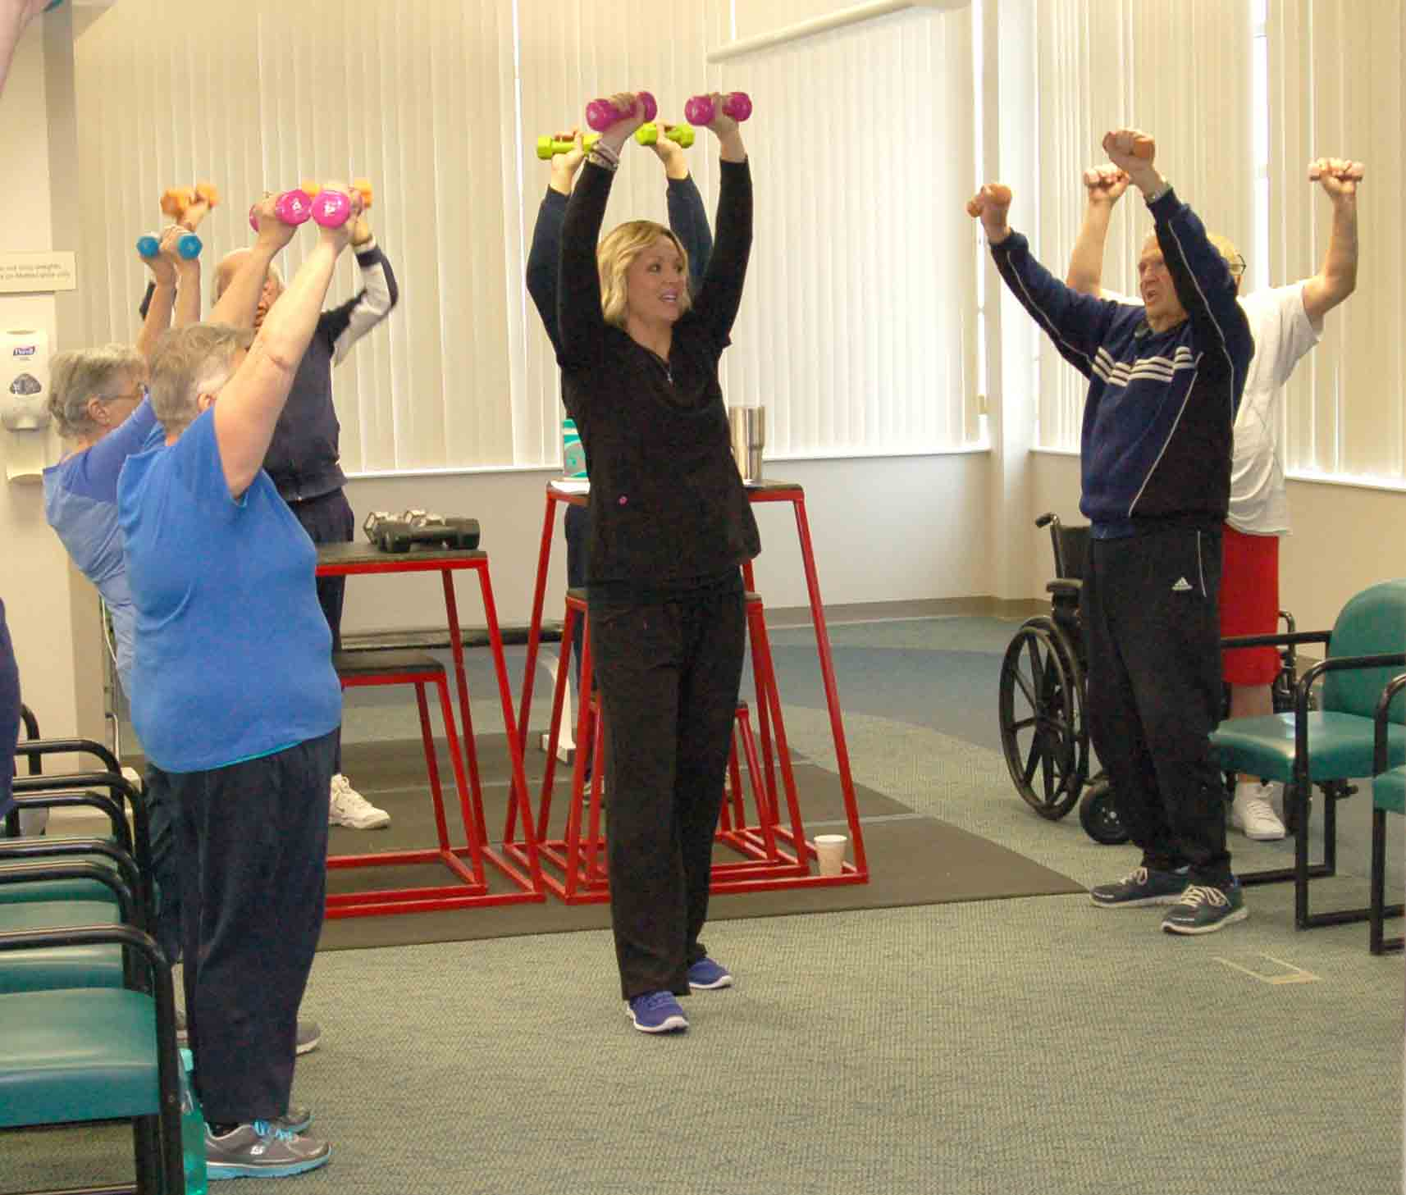
Pulmonary Rehabilitation
Abbie Masters
CResT Team Leader

Slide 2
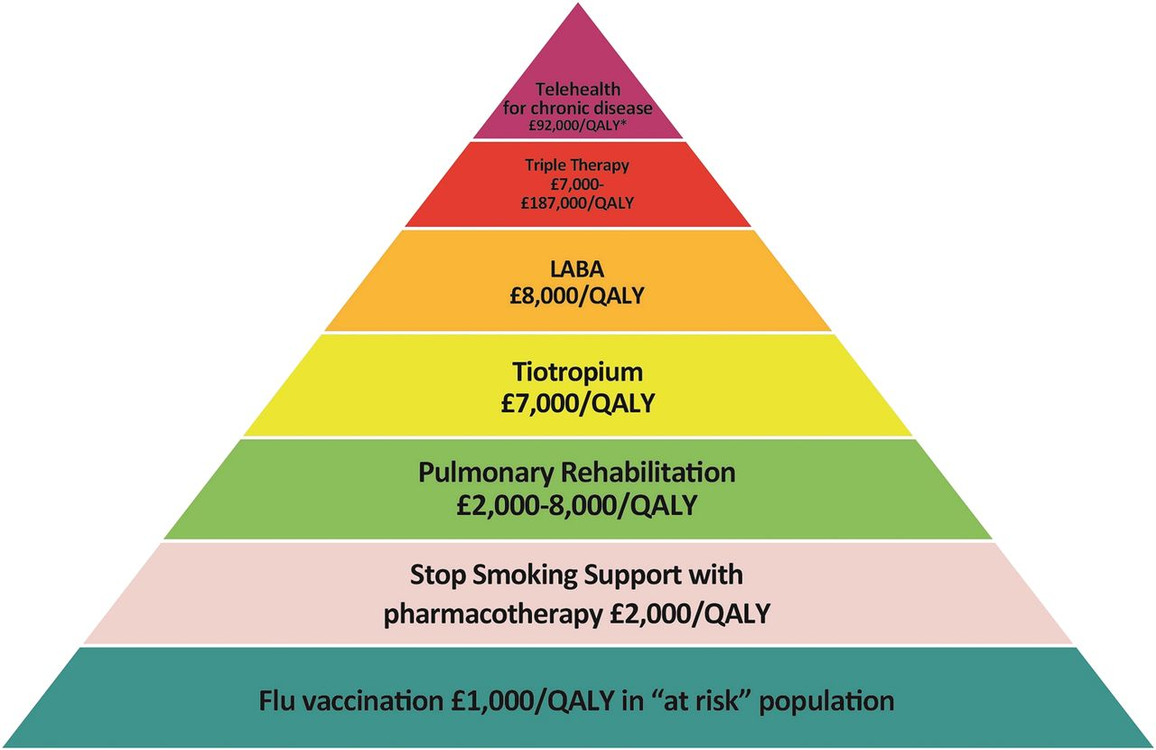
COPD Value Pyramid

Slide 3



Recap - completion of PR
Out of every 100 patients referred to PR:
59 enrol onto PR
69 attend an assessment
42 complete their PR
17 don’t complete PR
31 don’t attend an assessment
10 don’t enrol

Slide 4
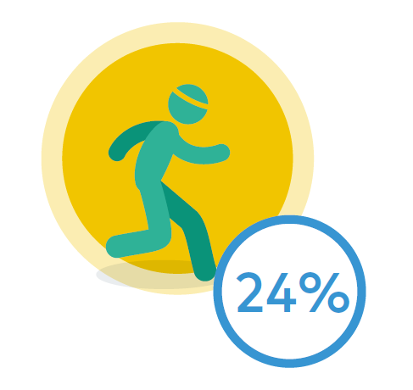
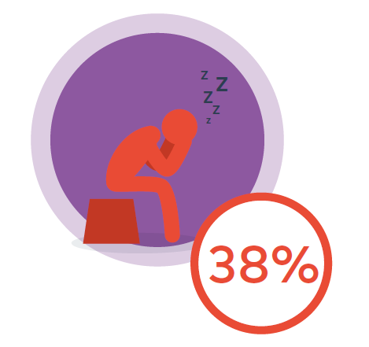
Admission rates
People with at least one admission within 180 days of PR assessment
People who completed PR
180 days
90 days
People who did not complete PR
Notes:
From RCP 2015 PR audit

Slide 5

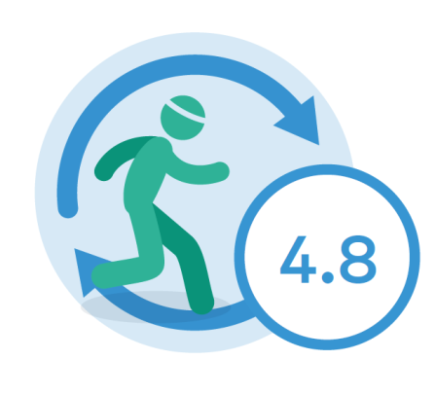

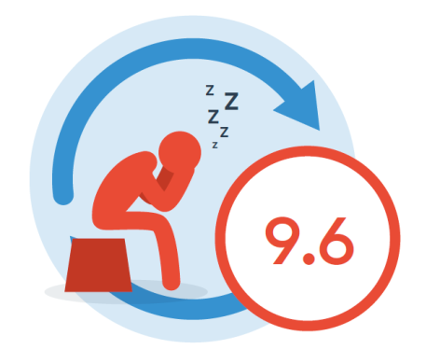
Bed days for those that were admitted
Mean bed days in the 180 days following PR assessment for:
Patients who completed their PR course was 4.8 days
Overall, the mean number of bed days spent in hospital within 90 days was 5.5 and within 180 days was 7.3
Patients who did not complete their PR course was 9.6

Slide 6
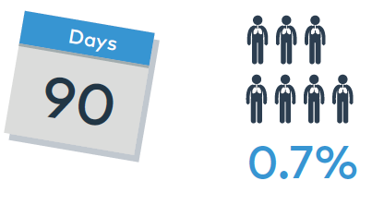
Mortality within 90 days
Overall mortality following assessment for PR:
In patients who did not complete PR, mortality was 1.6%.
In patients who did complete PR, mortality was 0.1%.

Slide 7
Who to Refer?
Any one with a chronic lung condition, functionally limited by their breathlessness MRC 2-5
Good motivation – need to attend twice a week for 6 weeks 2 hour sessions
Medically stable
Those awaiting pulmonary transplantation or post transplant.
Email: single point of access IRS service or
  rsch.crest@nhs.net
  rsc_tr.physio-RSCH@nhs.net
  Abbie.masters@nhs.net

Slide 8
Exclusion Criteria
Uncontrolled Asthma
Active Pulmonary TB
Unstable Angina
Severe Aortic Stenosis
Uncontrolled Hypertension, Diabetes, Heart failure, Arrhythmias
An orthopaedic condition that will limit training ability
Poor motivation

Slide 9
What happens?
Initial assessment – comprehensive background information, Spirometry, Walking test, QOL questionnaires
Offered classes:
  Royal Surrey Monday & Wednesday 10.15-12.15
  Wilfrid Noyce Monday &Wednesday 14.45-16.45
  Group warm up, Individualised Exercise, cool down and then a 30 minute education session
Discharge assessment
3 month follow up appointment

Slide 10
Continuation
Maintenance classes at Wilfrid Noyce or Woking leisure centre – chargeable
Referral on to local gyms – referral for health
Information given about local activities, walks, over 50’s classes, swimming, U3A etc

Slide 11
What are we doing?
PEPR patients included early in rehab
Keen to see more patients early on in their disease process
Allowing patients to repeat the course
Taking part in the rolling National Audit for COPD in Pulmonary Rehabilitation
Currently working towards accreditation of the service in conjunction with Kent, Surrey and Sussex network

Slide 12
What do patients say?
You have given me back control of my condition of my lungs and of my life.
Thank you for breathing fresh air into my life.
It was hard work but I will miss all the fun we had.
By understanding how to take my inhalers properly and doing the exercises with you the last infection I was strong enough to stay out of hospital.
I feel fit as a fiddle and now do my weights in the morning and walk at least half an hour a day. I have even gone back to work.

Slide 13
What can you do?
For patients that have previously attended, encourage them to keep up exercise
Encourage them to look through their information for self management – contact IRS if they are known to them
Re-refer if they have had a deterioration in their condition or completed rehab >1 year ago
Signpost to BLF literature give patients the ‘Get active stay active’ booklet

